Slide 1

Safeguarding Our Daily Bread:
Agrifood Systems Transformation for the Planet and for the Poor
Christopher B. Barrett
Cornell University
Presentation to COLLIS/Lumen Christi Institute program
Explorations in Integral Ecology: Science, Theology and Creation
Ithaca, NY
June 23, 2023

Slide 2
Laudato Si’
Pope Francis’ encyclical begins with a quote from St. Francis’ canticle of the creatures:
Laudato si, mi Signore, Praise be to you, my Lord,
per sora nostra matre Terra, through our Sister, Mother Earth,
la quale ne sustenta et gouerna, who sustains and governs us,
et produce diuersi fructi and who produces various fruit
con coloriti fior et herba. With colored flowers and herbs.
Pope Francis clearly explains the centrality of the Earth and all its creatures to God’s immanence. This may manifest most clearly in the agri-food systems that provide our ‘daily bread’.

Slide 3
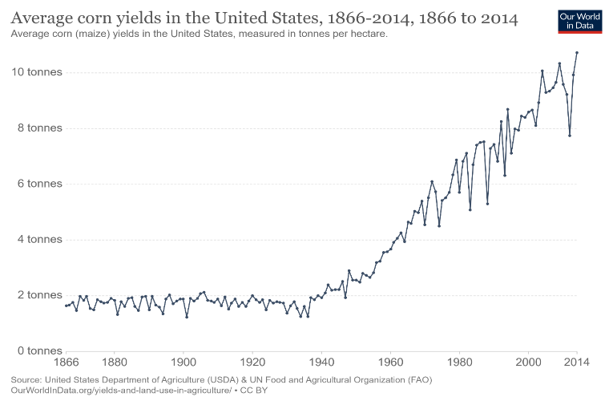
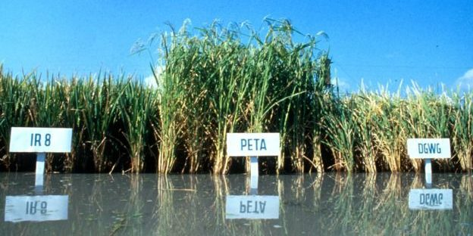

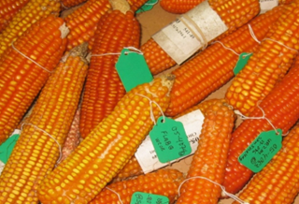
Indisputable successes
Humankind has tapped Mother Earth well, dramatically expanding global food supply to enable massive population growth while sharply reducing malnutrition rates:
Global pop grew from 2/3/4 bn in 1928/1960/1975 to 8 bn now … but ag total factor productivity (TFP) and dietary energy supplies grew even faster.
Close to 6 bn more people get adequate Kcal today than ~100 yrs ago.
Photo credits: IRRI, Edesia, Mike Gore

Slide 4
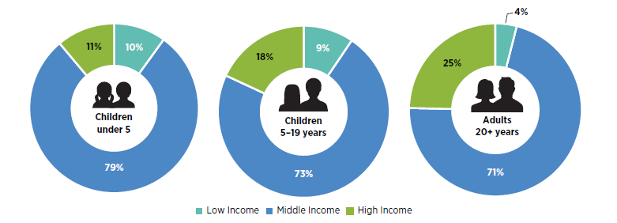
But unintended effects
The focus on starchy staples and calories predictably increased the relative price of nutrient-rich foods … esp. compared to ultra-processed foods made w/cheaper sugars/fats, while rising real wages rapidly boost demand for processed foods/FAFH.
Obesity became a global problem, not just (even mainly) a HIC one.
Share of world’s overweight/obese population
Source: Shekar and Popkin (2020)

Slide 5
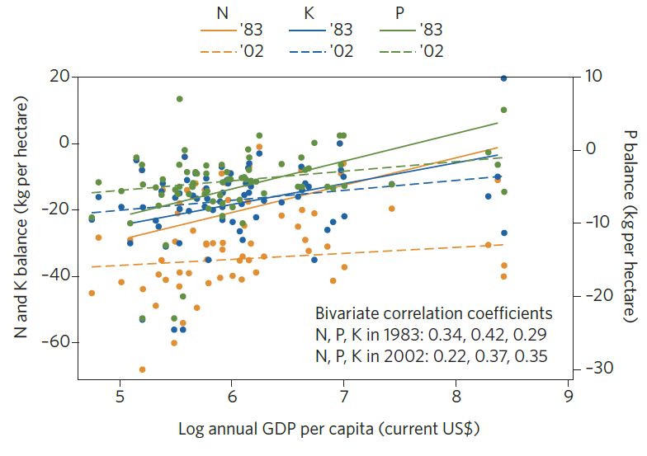
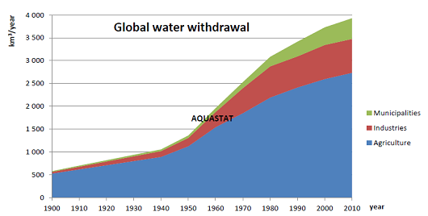
But unintended effects
More agri-food production, waste, and processing has overtaxed natural resources, esp. water, soils and climate.
- Globally, agriculture uses ~70% of water withdrawals, >80% in Africa and Asia. Key river basins suffer serious water stress. Worse w/climate change.
- Soil nutrients depletion a problem almost everywhere, esp. in poorest areas.
- Ag accounts f0r 24% GHG emissions (and could be a net C/N sink instead).
Ag soils N, P and K fluxes in sub-Saharan Africa, 1983-2002
Source: Barrett and Bevis Nature Geoscience 2015

Slide 6
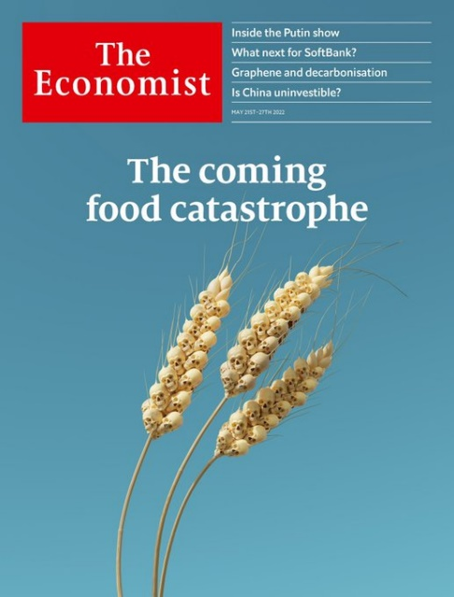
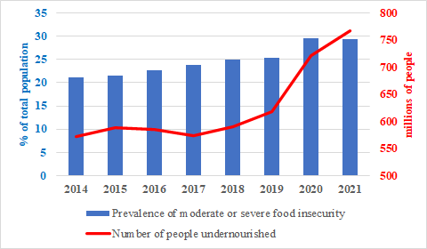
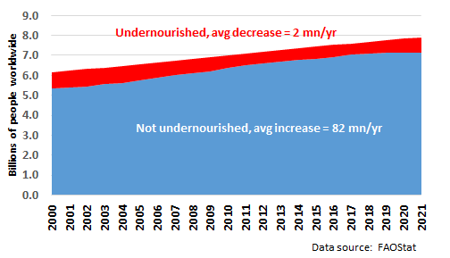
Now a global food security ‘crisis’
“The World Is Headed for a Food Security Crisis”
– Time, Mar 2018
“A Global Food Crisis Looms” – New York Times, Apr 2020
Is there a food security crisis currently?
Yes, increased human suffering
… but crisis ≈ stalled progress

Slide 7
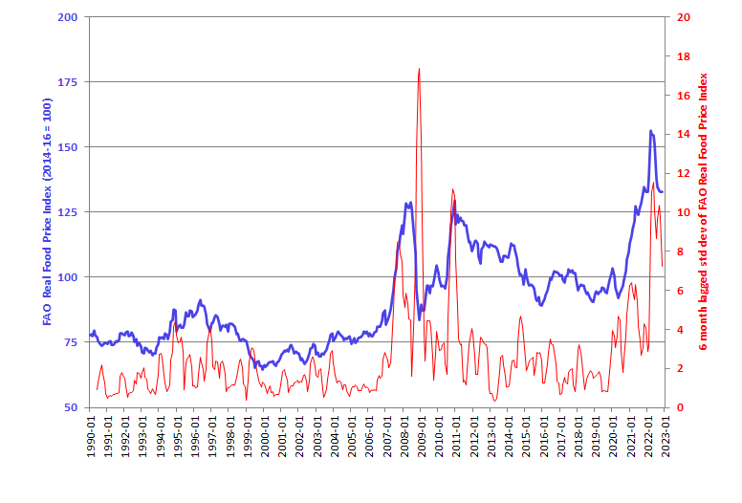
Why stalled progress?
Demand growth has outpaced supply growth since roughly 2000. This brought higher – and more volatile – commodity prices.

Slide 8
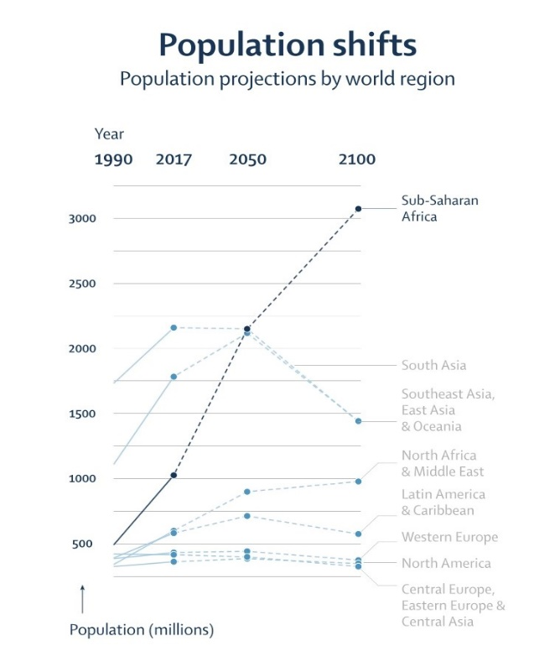
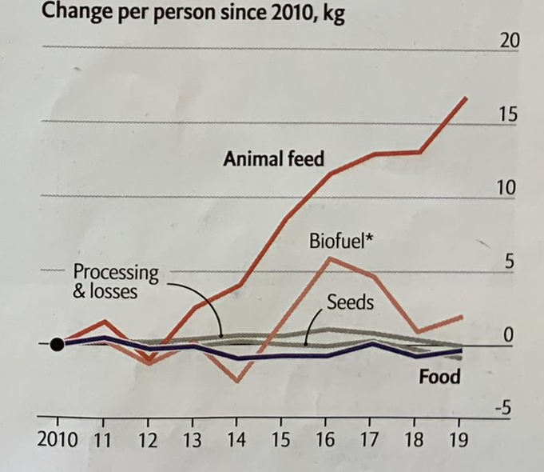
Why stalled progress?
Main long-run drivers:
1. Robust food demand growth, almost entirely in Asia and Africa
Due mainly to population/income growth
(and urbanization).
Policies don’t slow/shift demand much.
Vollset et al. Lancet 2020
Source: The Economist June 25, 2022

Slide 9
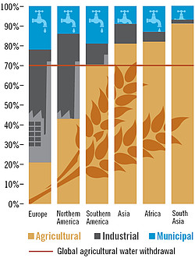
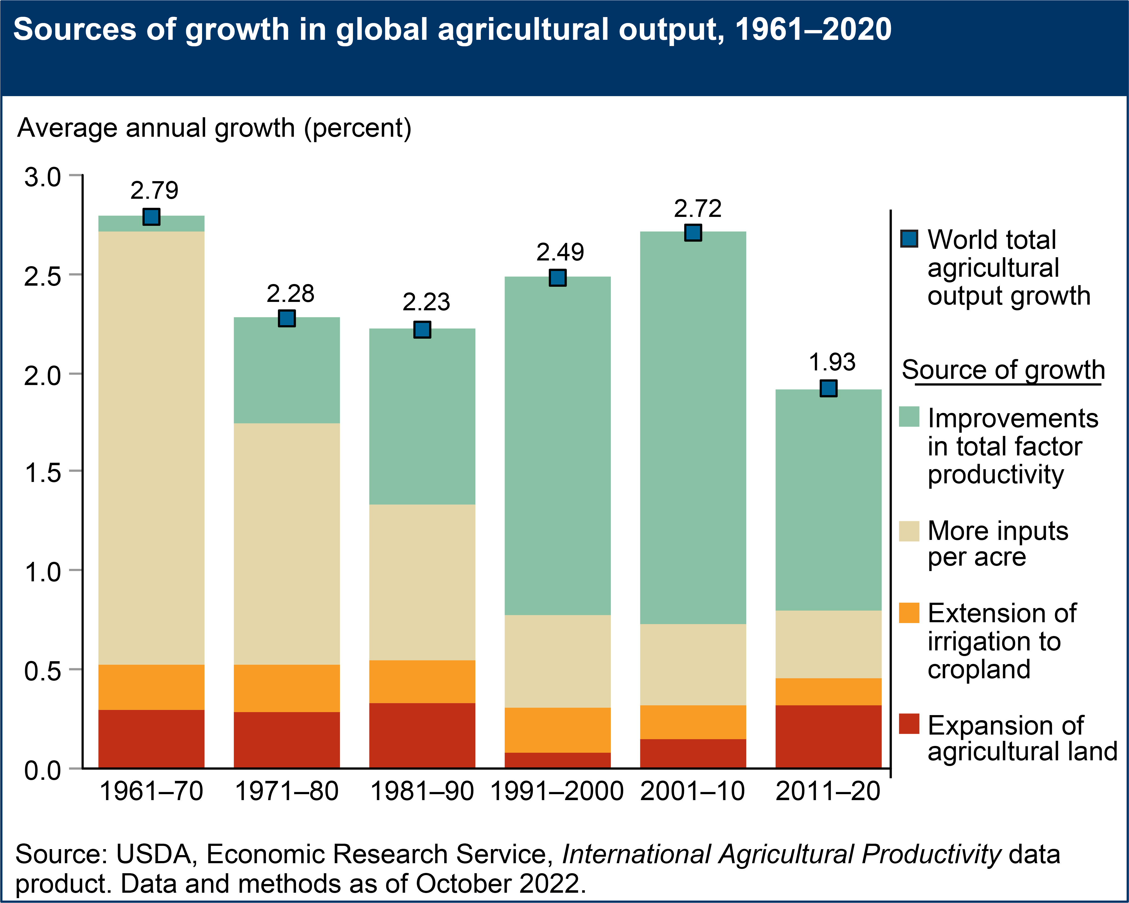
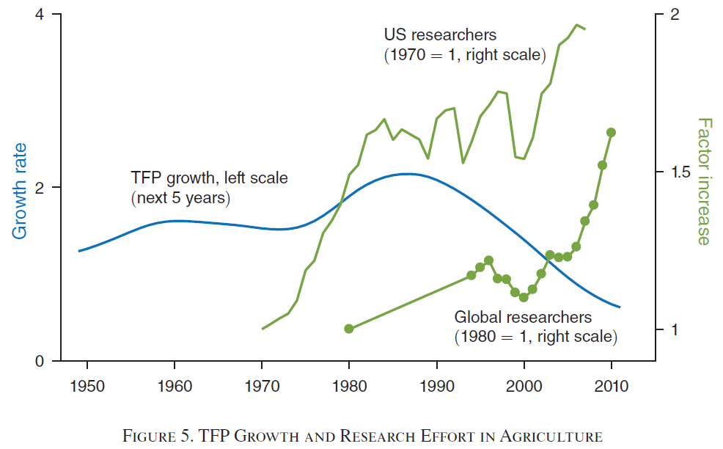
Why stalled progress?
2. Increasingly strong headwinds for supply growth
Land/water constraints + climate change + slowing productivity growth
Ag R&D productivity growth
-4-6%/yr (Bloom et al. AER 2020)
Source: https://www.globalagriculture.org/report-topics/water.html

Slide 10
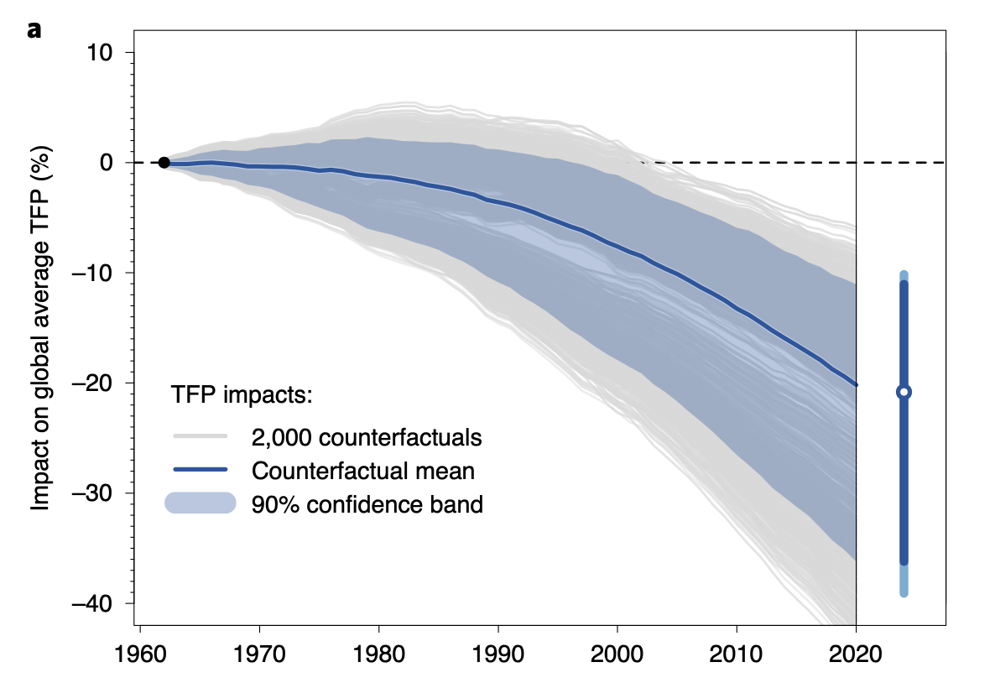
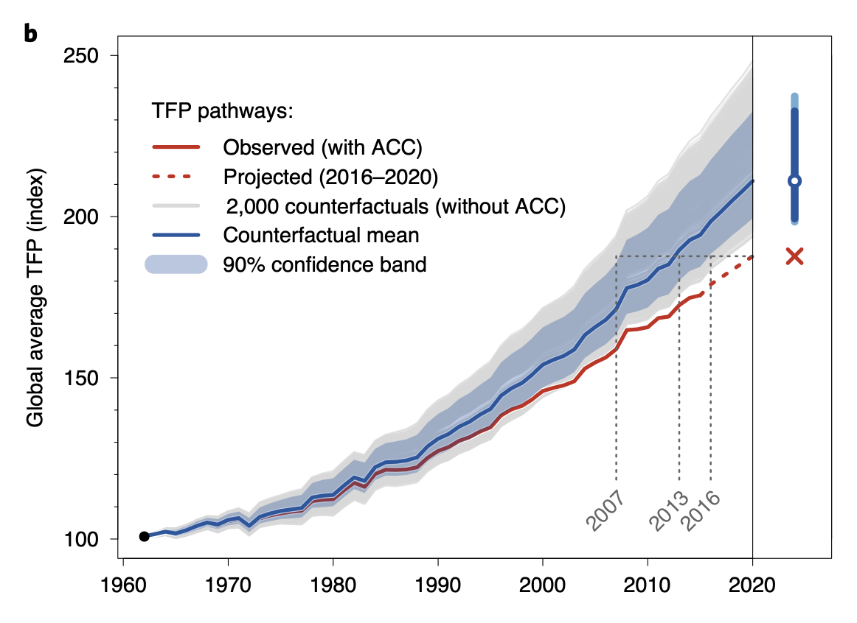
Why stalled progress?
Slowing agrifood productivity growth coupled with rising demand leaves the world vulnerable to ‘perfect storms’, which occur more often.
1. Climate change:
Fuel demand growth by forced displacement – climate refugees, droughts, etc.
Mainly it retards productivity advances and investment
Source: Ortiz-Bobea et al (Nature Climate Change, 2021)

Slide 11

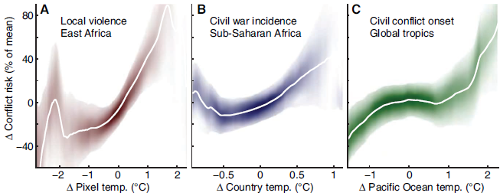
Why stalled progress?
2. Conflict:
>89mn forcibly displaced +~15mn Ukraine this year… highest on record
Conflict-affected nations >75% of stunted children globally (FAO et al. 2017)
Pop. in fragile settings growing. >2bn now, ~ 80% world’s poor (OECD 2018)
Food insecurity destabilizes societies lacking strong social
safety nets. Unrest in ~50 nations 2007-12. Sri Lanka now.
And climate change makes it worse …
(Hsiang et al. 2013)

Slide 12
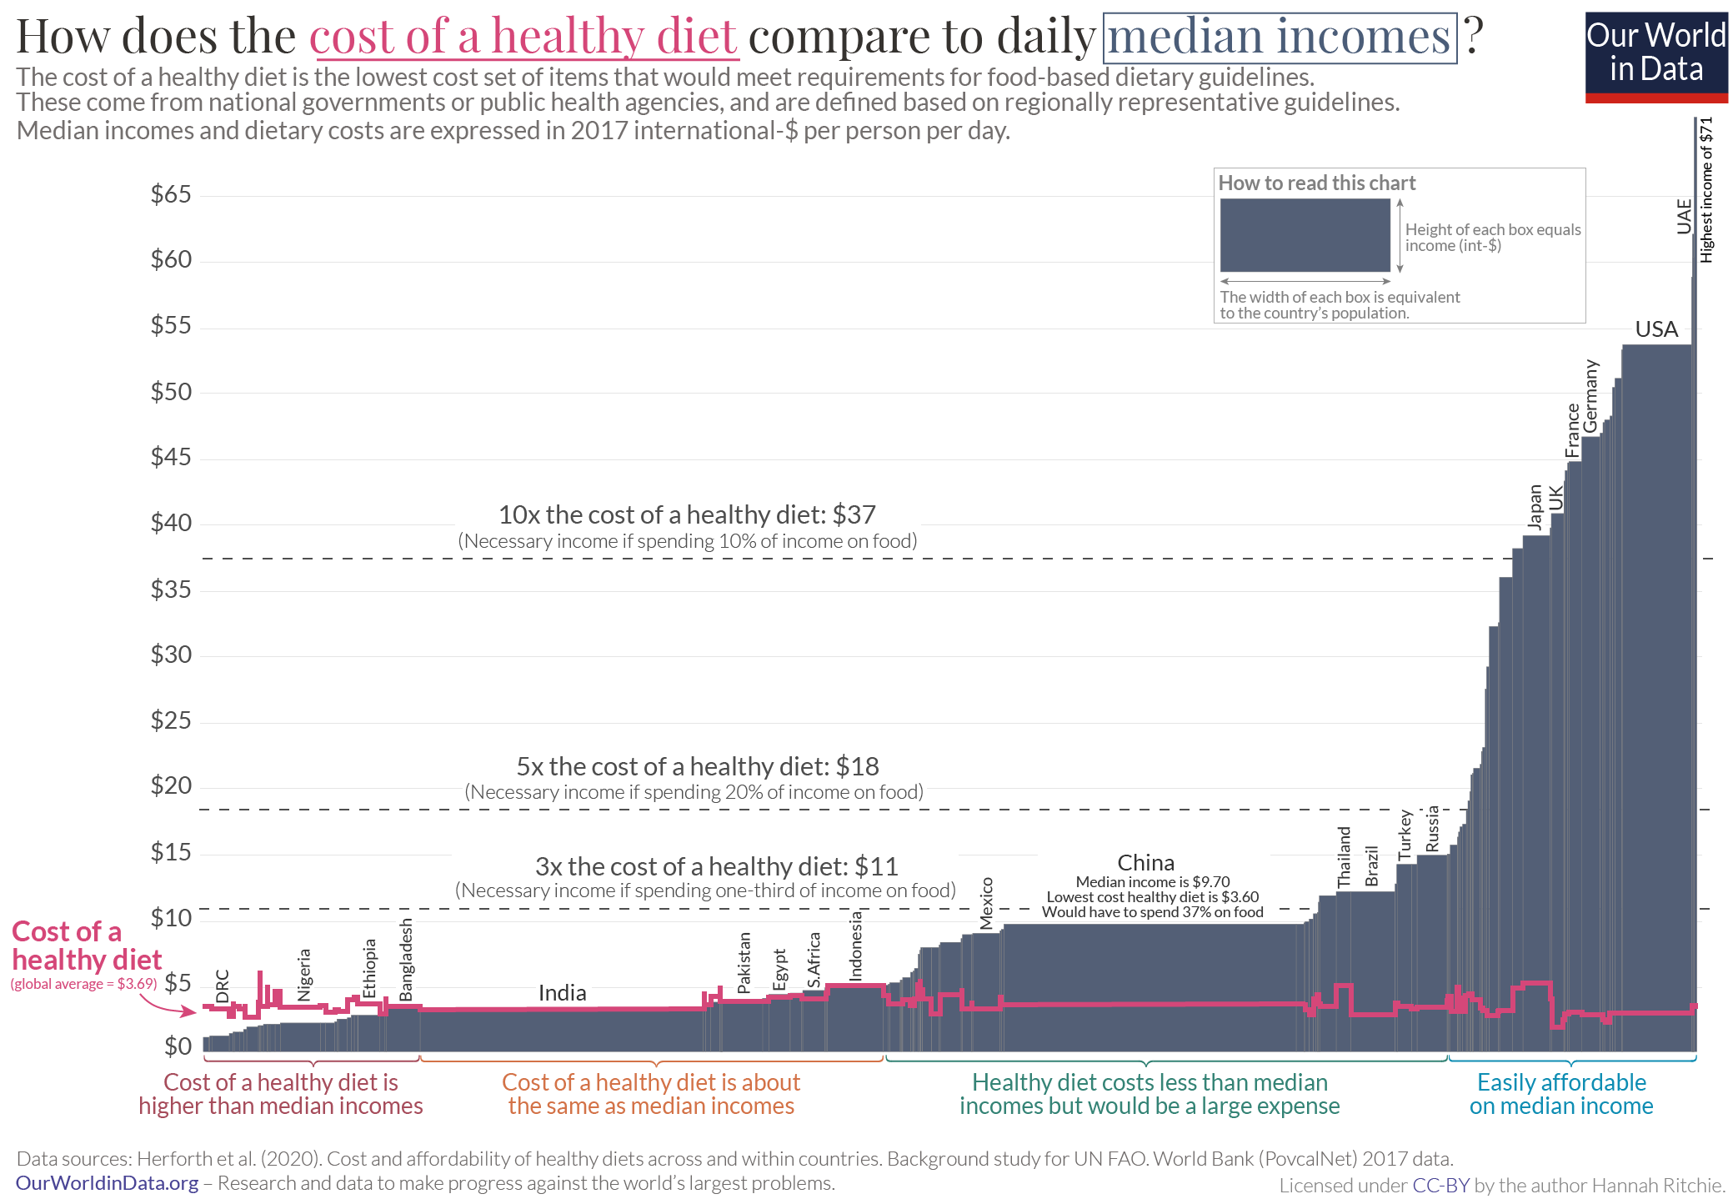
Why stalled progress?
3. Macroeconomic growth and stability
Poverty is main cause of food insecurity. COVID slowed growth; poverty rose. Macro instability fuels flight to dollar, debt/food prices worsen in LMICs. >3 bn cannot afford a healthy diet. Safety nets are currently insufficient.

Slide 13
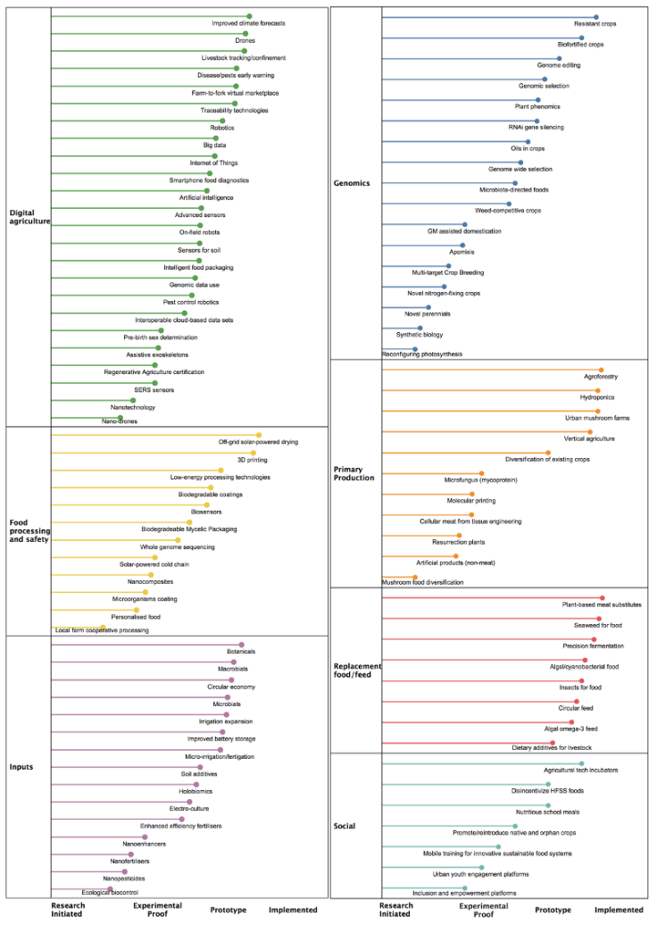
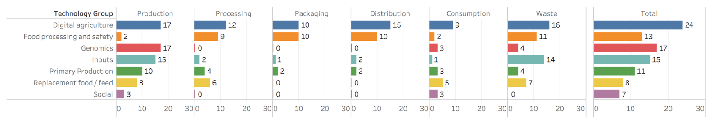
Induced innovation
Rising real prices and sustainability/health concerns induce investment/innovation.
Global agrifood tech VC investment $52bn in 2021 … up 85% over 2020 and ~600% vs. 2016!
Many promising pre-emergent/emergent science, technology and innovations (STI) advances of variable deployment readiness.
Massive change is coming.

Slide 14
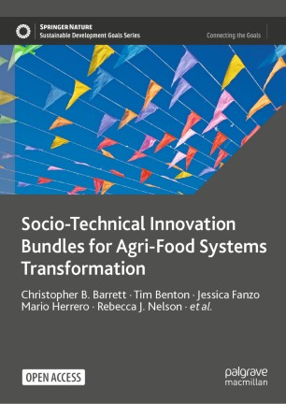
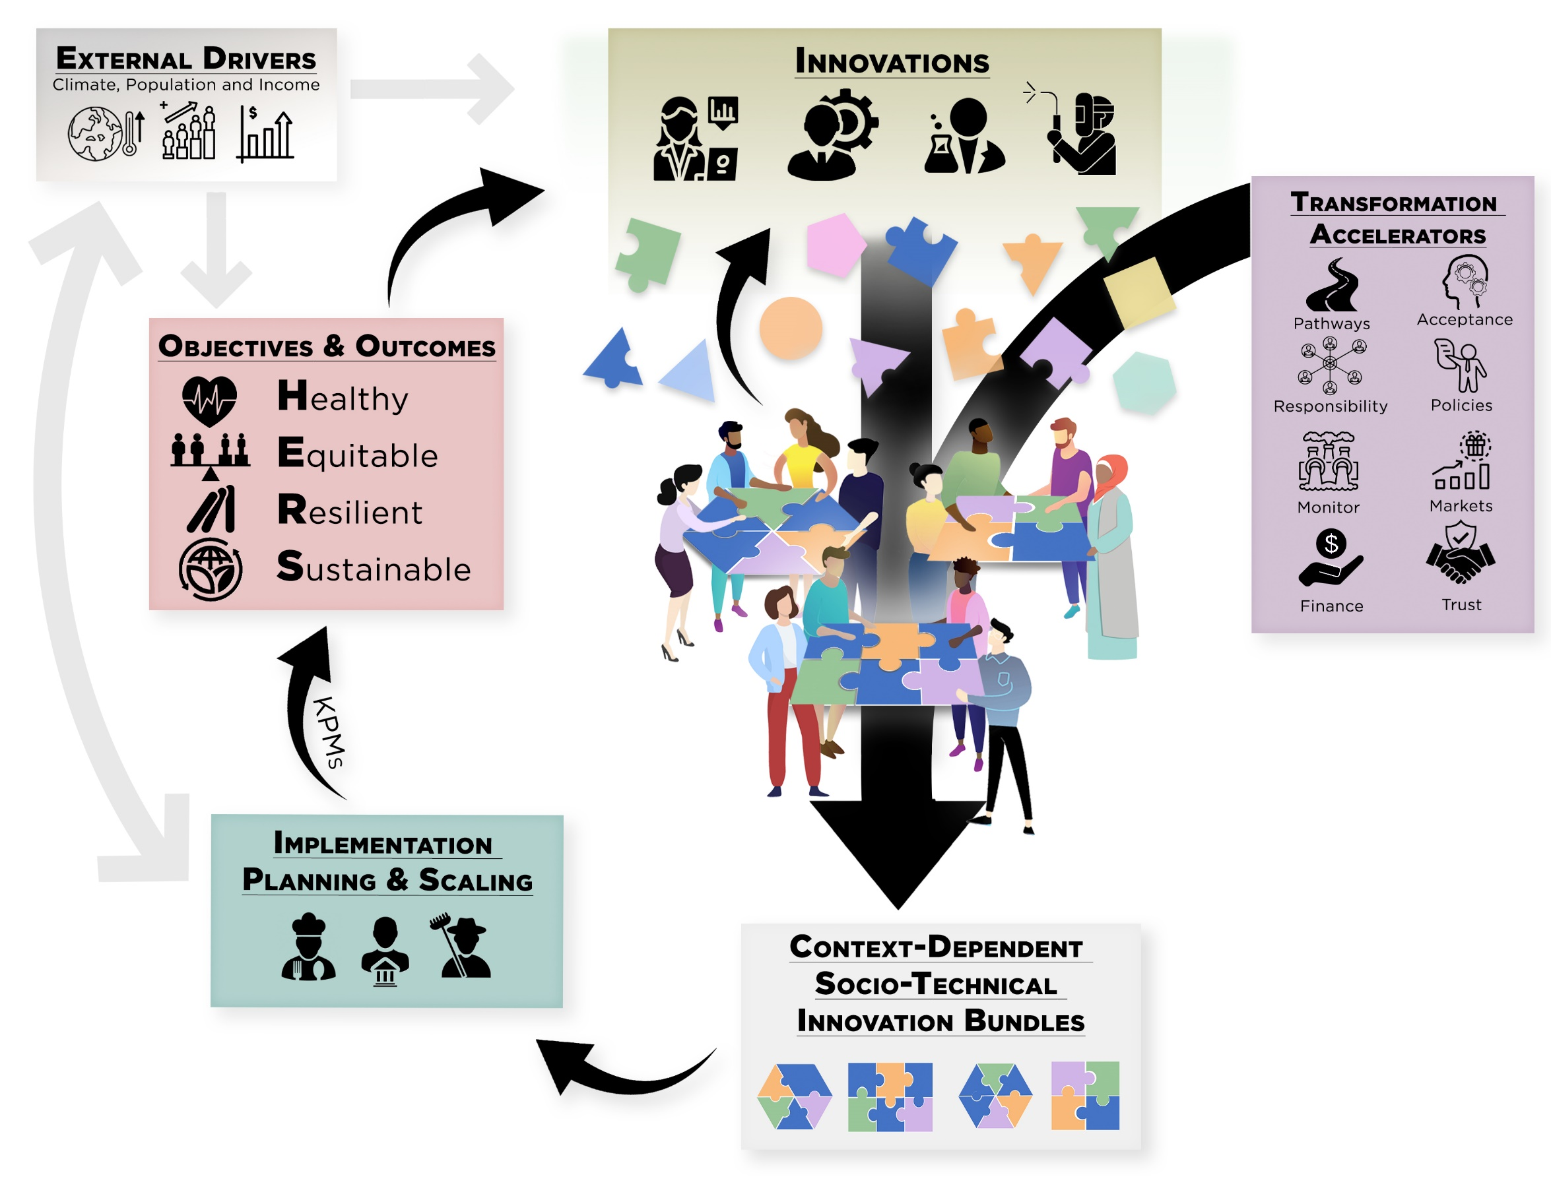
The innovation imperative
The objectives of 21st century agrifood system innovation are shifting.
Profit-seeking less by boosting yields than relieving land/water/ chemical constraints and not from growing more calories but rather by meeting rising consumer demand for non-caloric attributes.
Like
Solutions are never just technical. Like prior successful AFS transformations, must bundle both technological and socio-economic innovations.

Slide 15
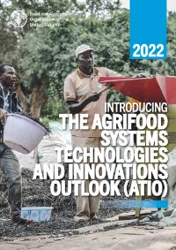
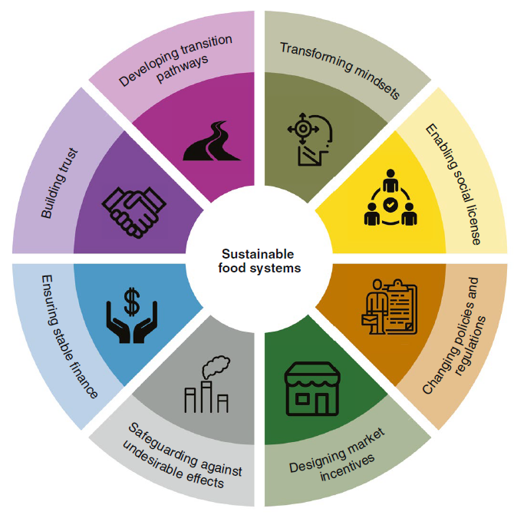
Accelerate AFS transformation
Must shorten lag from AFS R&D to impact at scale (presently 10-20 yrs)
Policy/regulatory obstacles: IP thickets, anti-science movements, protectionist labeling laws, etc.
Level informational playing fields for LMICs through open source sharing of precompetitive data to crowd in public/philanthropic investments.
Need more R&D, but R&D without
policy/social change underdelivers
(Herrero et al. Nature Food 2020)

Slide 16
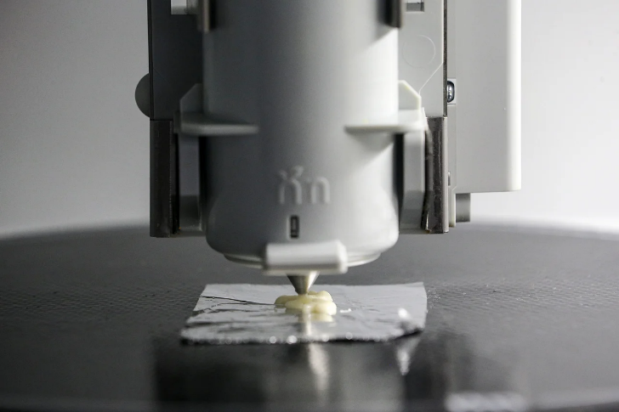
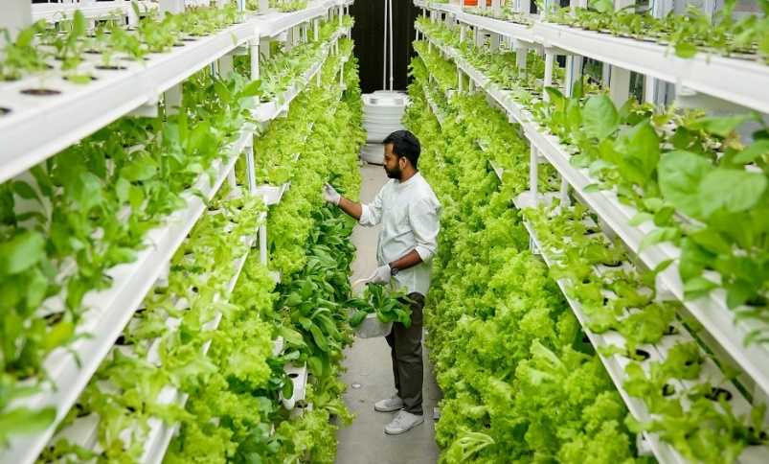
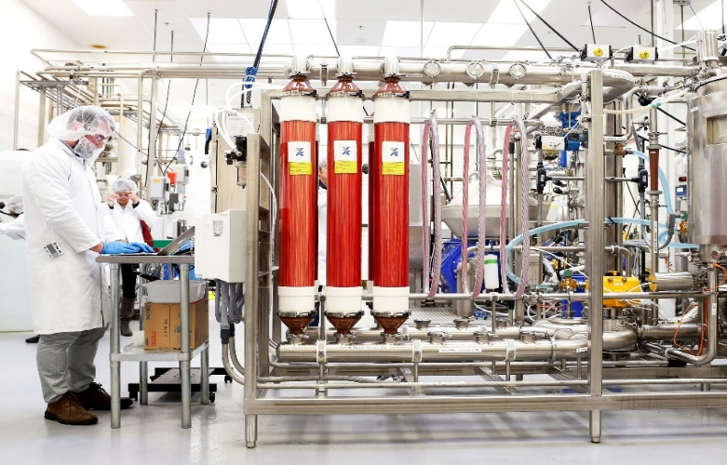
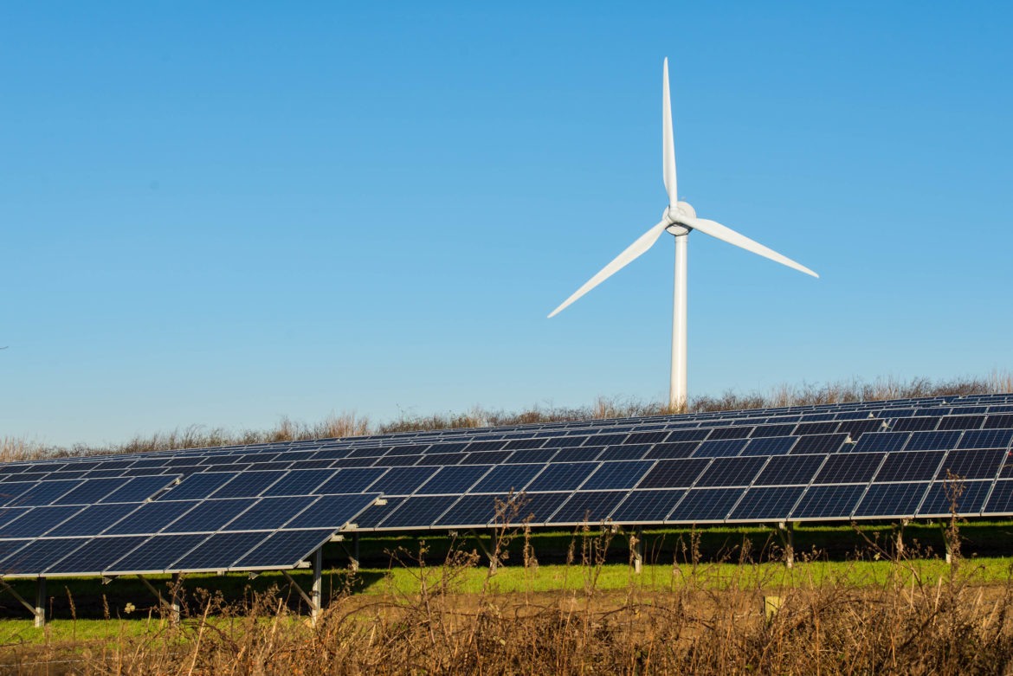
De-agrarianization
Decoupling food production from land is increasingly culturally, economically, technologically feasible. Crucial for climate and infectious disease control.
Photo: Wallace Woon (Straits Times)
Photo: Betterindia.com
Photo: Beck Deifenbach/Reuters
Inevitable. Learn the lesson of rennet.
Must manage de-agrarianization’s creative destruction
proactively. Build rural livelihood opportunities: farm carbon, solar, wind and wildlife; CEA in idle, low-cost structures.
Photo: Gerry Machen/Creative Commons

Slide 17
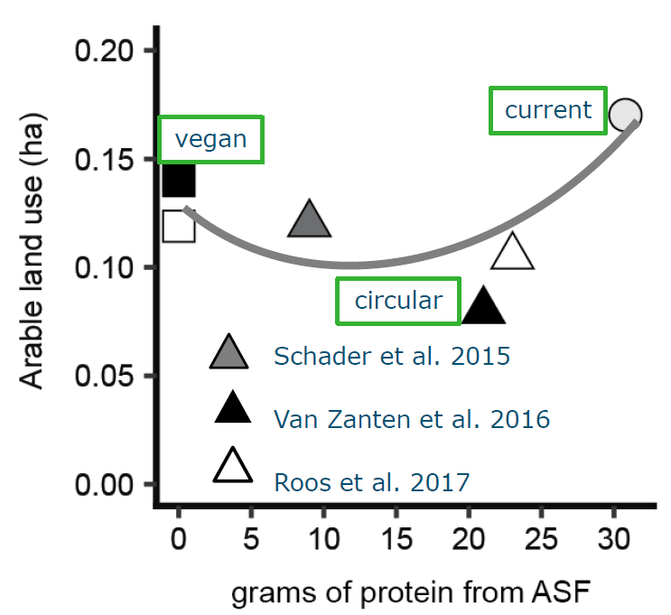
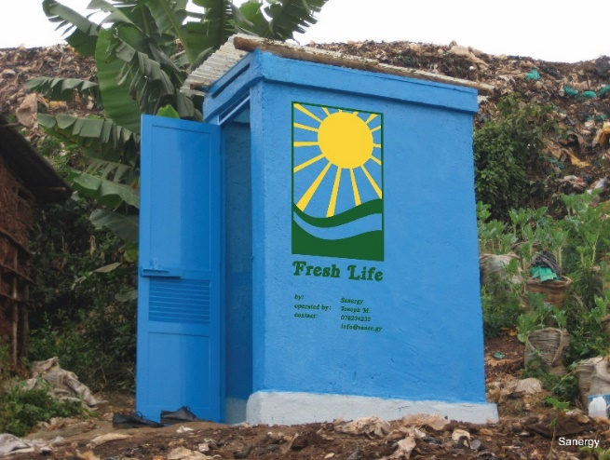
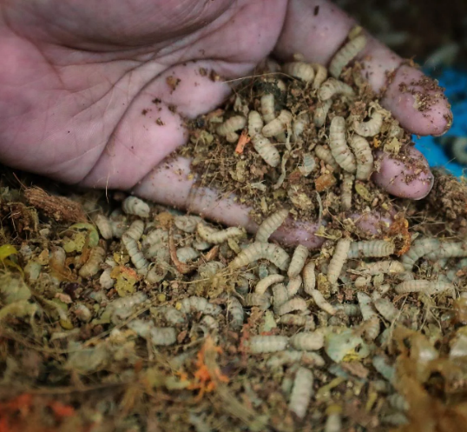
Circularity
Need cheap food for the poor. But cheap food inevitably induces loss and waste.
Recapture the nutrients as feed and fertilizer to help de-agrarianize!
Credits: Sanergy; Andrew Simons et al.; Jason Quah, Straits Times; H. Van Zanten
Can maintain 2/3 animal-source foods consumption w/o food-feed competition.
Reduce cost and geopolitical/mkt vulnerability to NPK supply disruption.

Slide 18
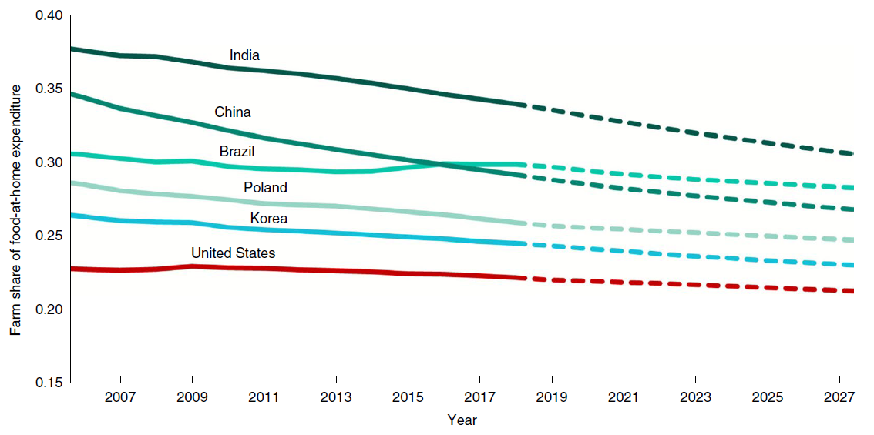
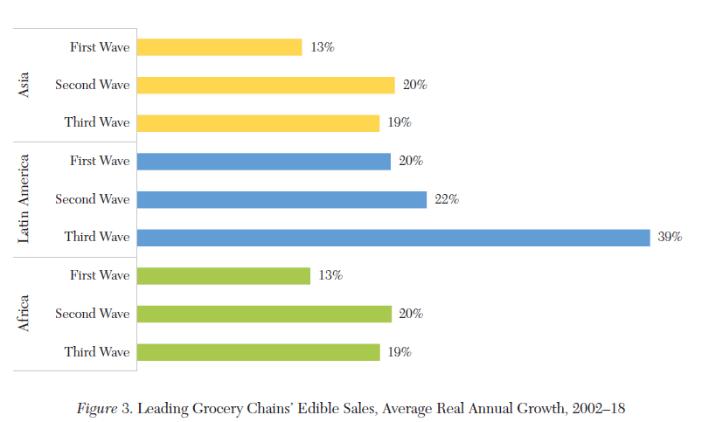
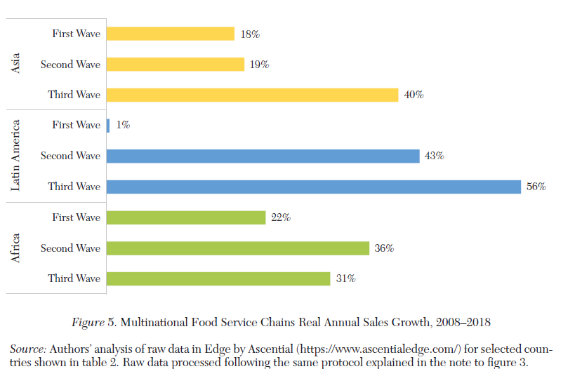
Downstream changes
Most AFS jobs, ultra-processing/fortification, and value creation (~3/4 globally!) occur post-farmgate and that share grows with incomes and ag TFP growth.
Big environmental impacts, too. Businesses drive AFS transformation!
Consumers and downstream firms increasingly drive AFS change!
LMIC grocery stores LMIC MNC food service
Source: Yi et al., Nature Food 2021
Source: Barrett et al., J. Econ.Lit. 2022

Slide 19
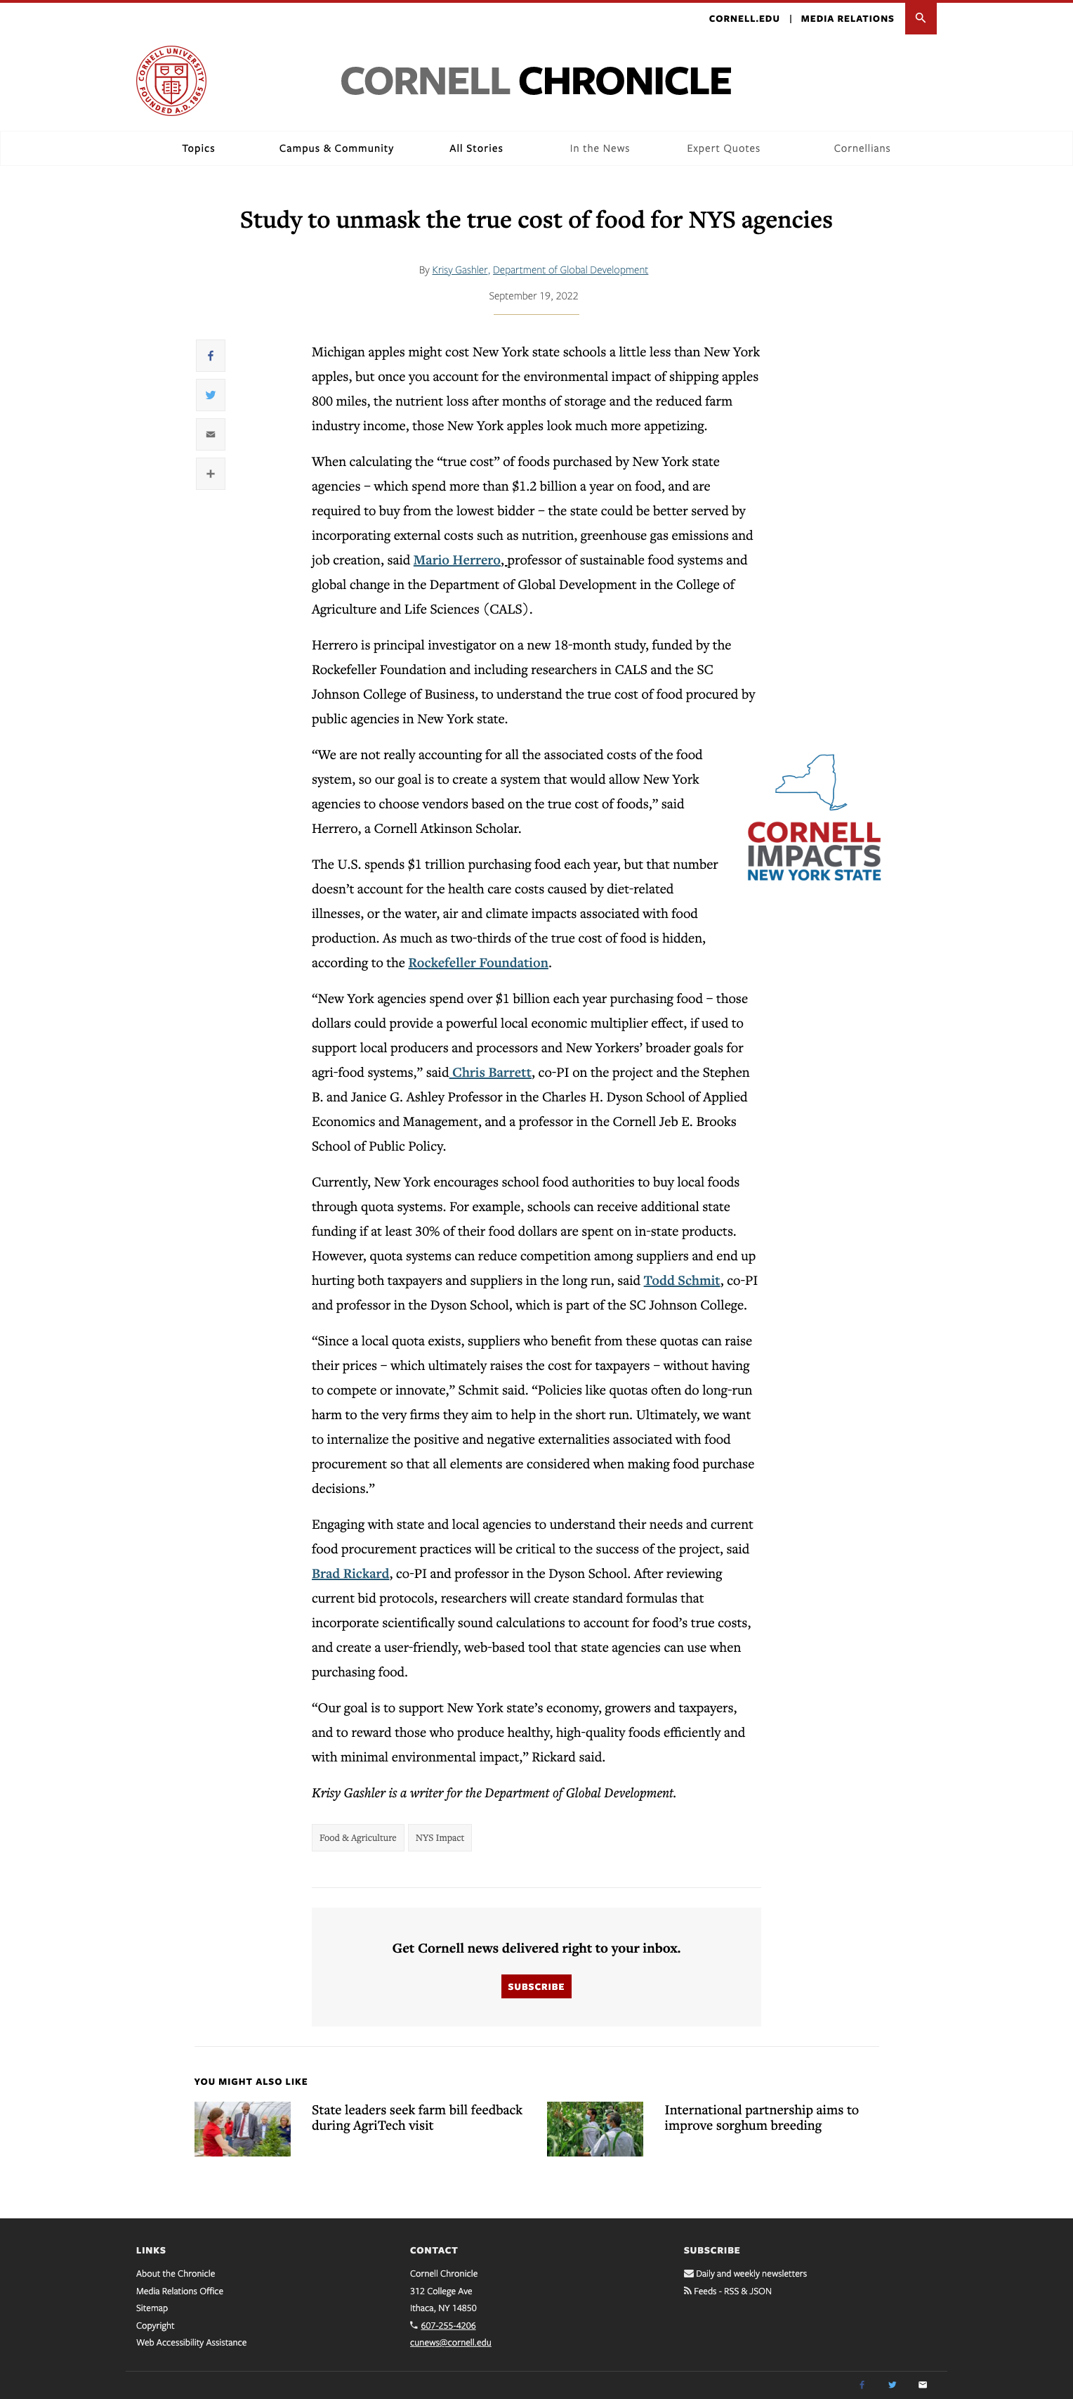
True cost pricing
in public procurement
THE TRUE COST OF FOOD PROJECT
$1.2B
Current law requires state agencies to procure food from the lowest qualified budder.
Those prices don’t reflect important (+ and -) externalities like job creation, GHG emissions, nutrient content. This hides the true, longer-term cost of food to NY taxpayers.
And NY producers/processors disadvantaged by NY laws/regulations.
True cost pricing to induce ‘race to the top’ and level the playing field for NY suppliers.
The amount New York state agencies spend each year purchasing food.
03
cals.cornell.edu/food-systems-global-change/true-cost-food

Slide 20
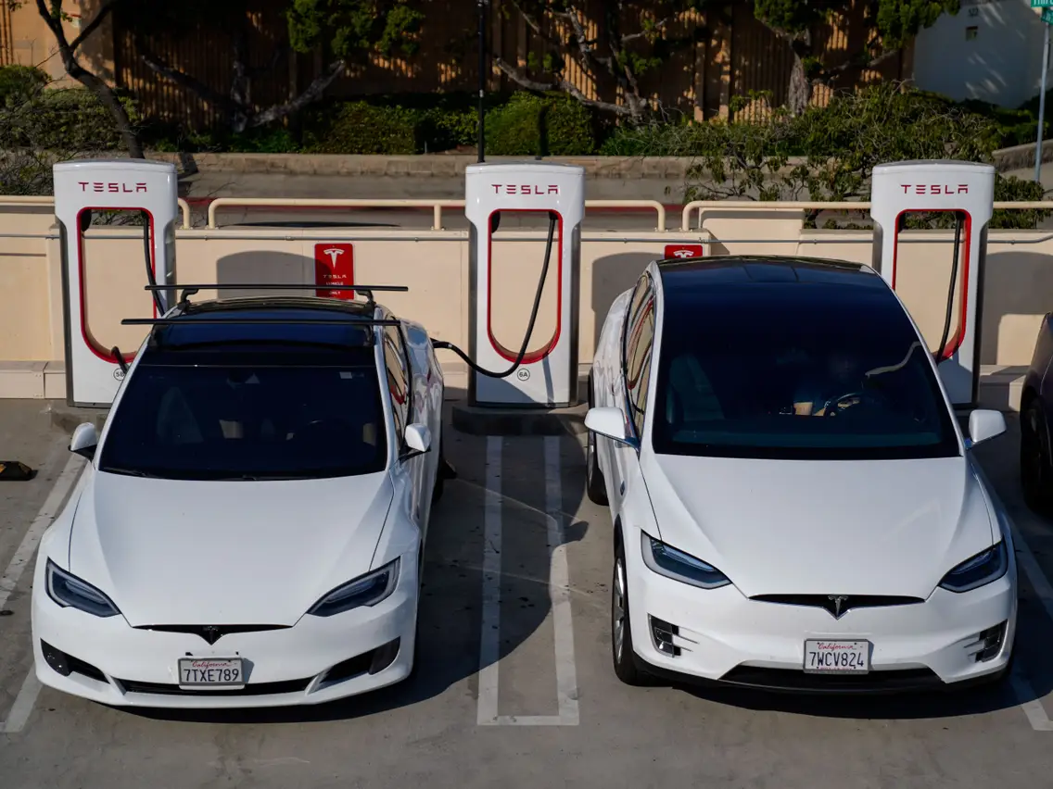

Why should we care?
Solving societal problems can be a lucrative business strategy
Human rights, sociopolitical stability, and macroeconomic growth and stability all depend on food security

Slide 21
Don’t despair, but don’t dally
The world faces a food security crisis because land, water and biochemical constraints increasingly bind in the face of growing demand, slowing progress. We have prevailed before in food crises and can again … will we?
Requires:
doubly progressive strategy – trust science and support the poor
focus on HERS objectives and invest in STI, incl. circularity,
de-agrarianization, and true cost public procurement
Thank you for your time and interest!
What questions can I answer for you?

